Slide 1

School of Electronics Engineering (SENSE)
FPGA-Based AES Encryption and Decryption
for
Data Security
Team Members:
Boga Vivek - 25MVD1005
Manchem Sai Kiran - 25MVD1011
K Arun Kumar – 25MVD10128
Faculty: Dr. Augusta Sophy Beulet P

Slide 2
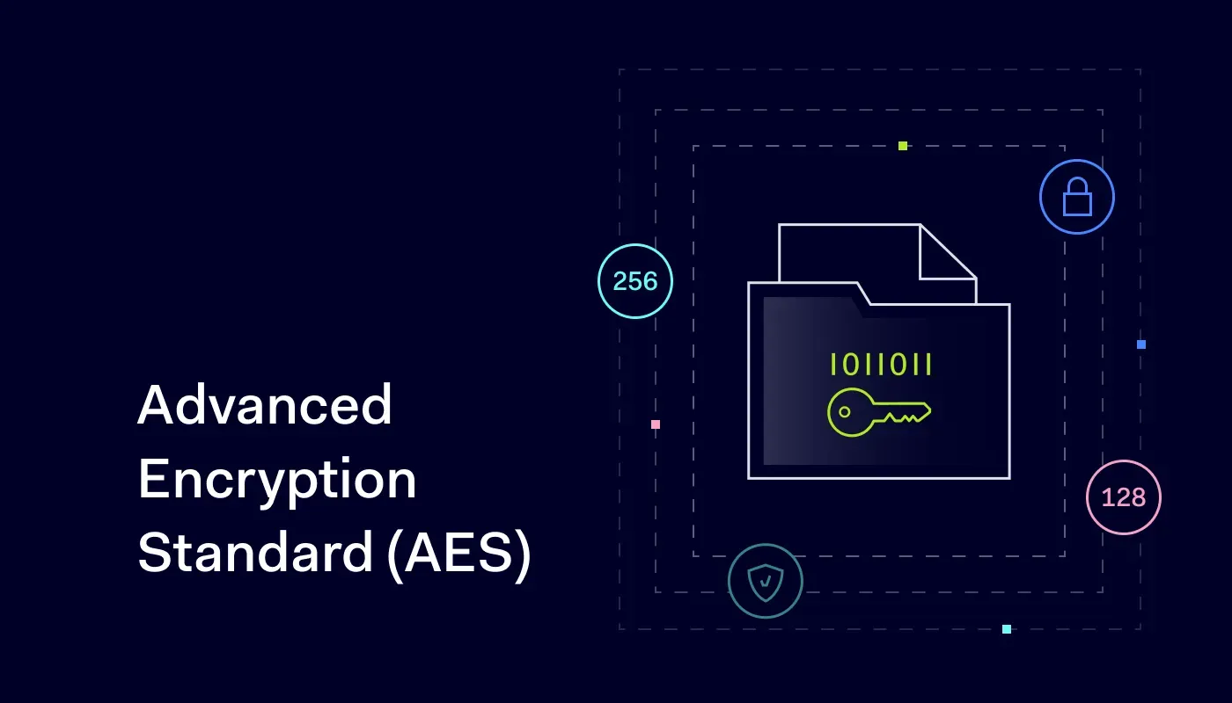
Project Objective
To design and implement a 128-bit AES encryption and decryption system on FPGA. The project aims to utilize hardware parallelism to improve speed and efficiency. This ensures secure and real-time data protection for modern applications.

Slide 3
Introduction
Advanced Encryption Standard (AES) is a symmetric block cipher developed by NIST.
Operates on fixed 128-bit data blocks with key sizes of 128, 192, and 256 bits.
Provides confidentiality, integrity, and reliability in data security.
Extensively used in:
Secure communications
IoT devices
Cloud storage
Military and financial systems
Why FPGA?
High-speed parallel processing
Efficient hardware resource utilization
Real-time encryption/decryption capability

Slide 4
Methodology
Encryption
Decryption
Input: Plaintext block of 128 bits and a 128-bit key.
Key Expansion: Generate 11 round keys
(1 initial + 10 rounds).
Initial Round (Pre-round):
AddRoundKey (plaintext ⊕ round key 0).
Rounds (1–9): Each round consists of:
SubBytes (non-linear substitution using S-box).
ShiftRows (row-wise cyclic shift).
MixColumns (mixes data within columns for diffusion).
AddRoundKey (XOR with round key).
Final Round (Round 10):
SubBytes
ShiftRows
AddRoundKey (no MixColumns here).
Output: Ciphertext (128-bit).
Input: Ciphertext block of 128 bits and the same 128-bit key.
Key Expansion (same round keys, used in reverse order).
Initial Round:
AddRoundKey (ciphertext ⊕ last round key).
Rounds (1–9): Each round consists of:
InvShiftRows (reverse row shift).
InvSubBytes (inverse S-box substitution).
AddRoundKey.
InvMixColumns.
Final Round:
InvShiftRows
InvSubBytes
AddRoundKey (no InvMixColumns).
Output: Original 128-bit plaintext.

Slide 5
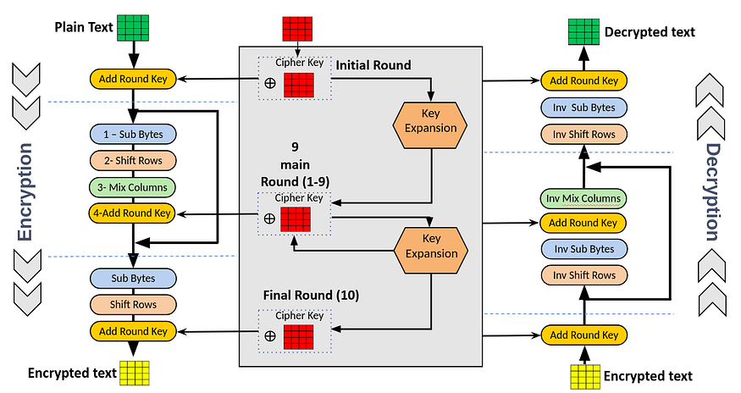
Architecture flow

Slide 6
AES (Encryption And Decryption)
The 128-bit plaintext is first arranged into a 4×4 byte matrix called the state matrix.
In the Initial Round, the plaintext matrix is combined with the cipher key using the Add Round Key operation.
Each of the 9 Main Rounds performs four steps: SubBytes, ShiftRows, MixColumns, and Add Round Key.
In the SubBytes step, every byte in the matrix is replaced by a corresponding value from the S-Box.
The ShiftRows step rearranges the bytes by shifting rows cyclically by different offsets.
The MixColumns step mixes the data in each column using a fixed matrix multiplication.
The Final Round includes only SubBytes, ShiftRows, and Add Round Key (MixColumns is skipped).
For Decryption, all these operations are reversed in order using the inverse transformations (InvShiftRows, InvSubBytes, InvMixColumns, and AddRoundKey).

Slide 7
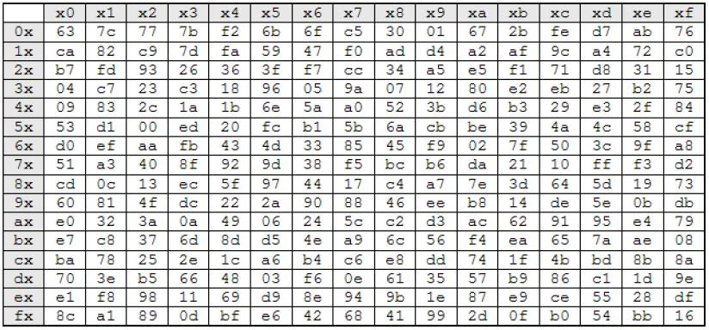
S - BOX (Substitution Box)
The S-Box is used in both the SubBytes step and key expansion function to perform byte substitution, ensuring that each input byte is replaced with a unique nonlinear output based on predefined lookup values.
The AES S-Box is a 16×16 substitution matrix that maps each 8-bit input to a unique 8-bit output using algebraic transformations in the finite field GF(2⁸).

Slide 8
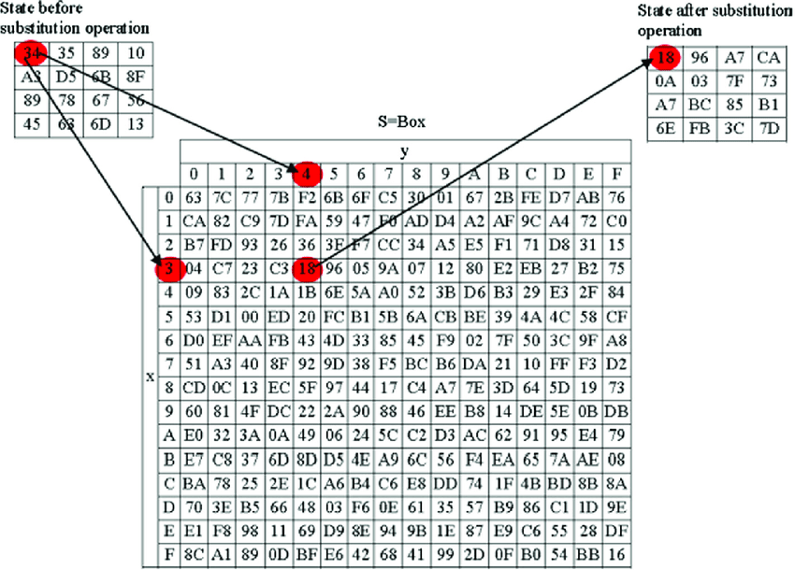
Sub Bytes Operation
Each byte in the state matrix is replaced by another byte from the S-Box lookup table.
This substitution is done individually for all 16 bytes using their hexadecimal values as row and column indices.

Slide 9
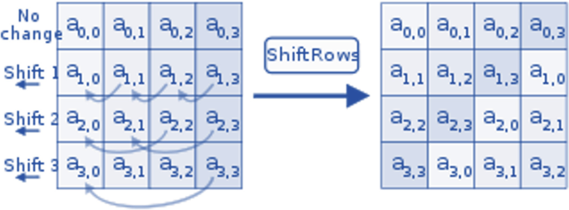
Shift Rows Operation
In this step, the first row remains unchanged while the second, third, and fourth rows are cyclically shifted left by 1, 2, and 3 bytes respectively.
This operation moves bytes between columns, helping spread data across the matrix.

Slide 10
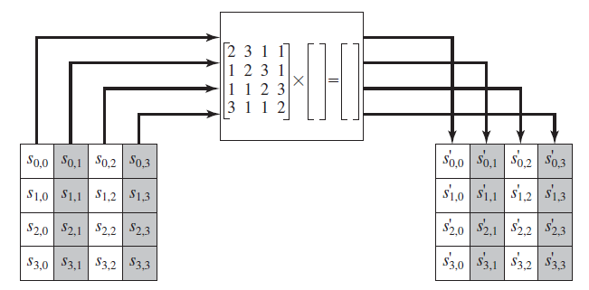
Mix columns operation
Each column of the state matrix is treated as a 4-byte vector and multiplied with a fixed matrix in GF(2⁸).
The four output bytes from each column are linear combinations of the input column bytes, effectively mixing them.

Slide 11
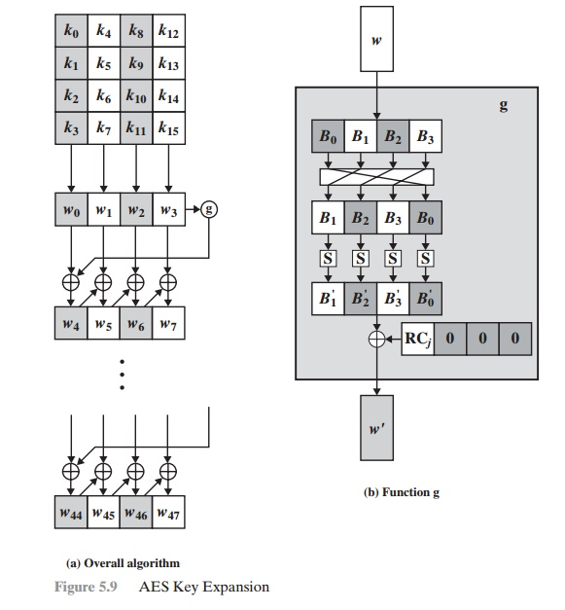
Key Expansion Operation
The original cipher key is divided into four 32-bit words and expanded into a total of 44 words to generate round keys for all encryption rounds.
Each new word is formed by combining earlier words and passing one through the g() function, which performs rotation, byte substitution (S-Box), and addition of a round constant.

Slide 12
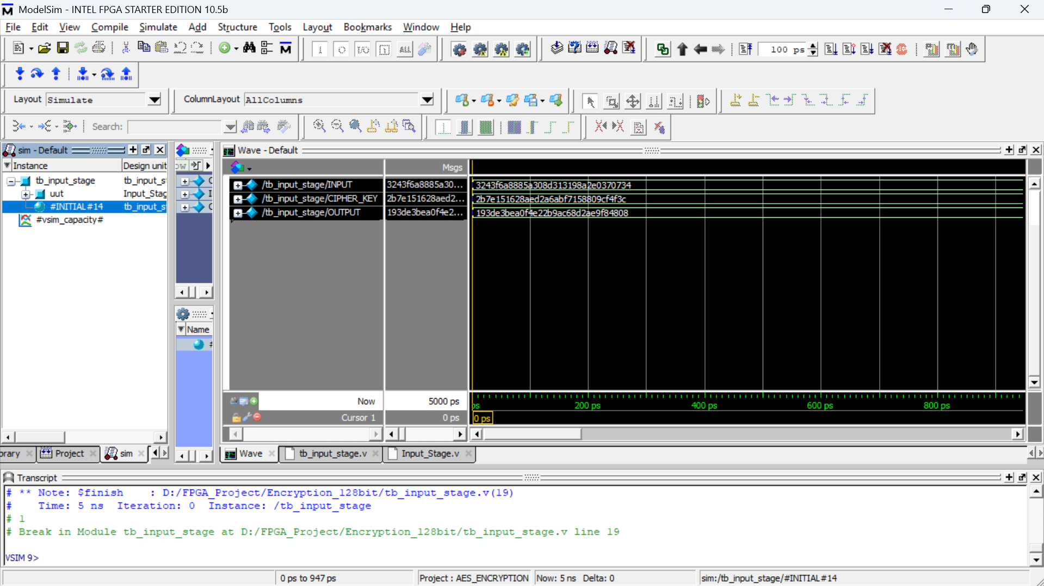
Results (Encryption)
Initial Input Stage: (Plain text ^ Cipher Key)

Slide 13
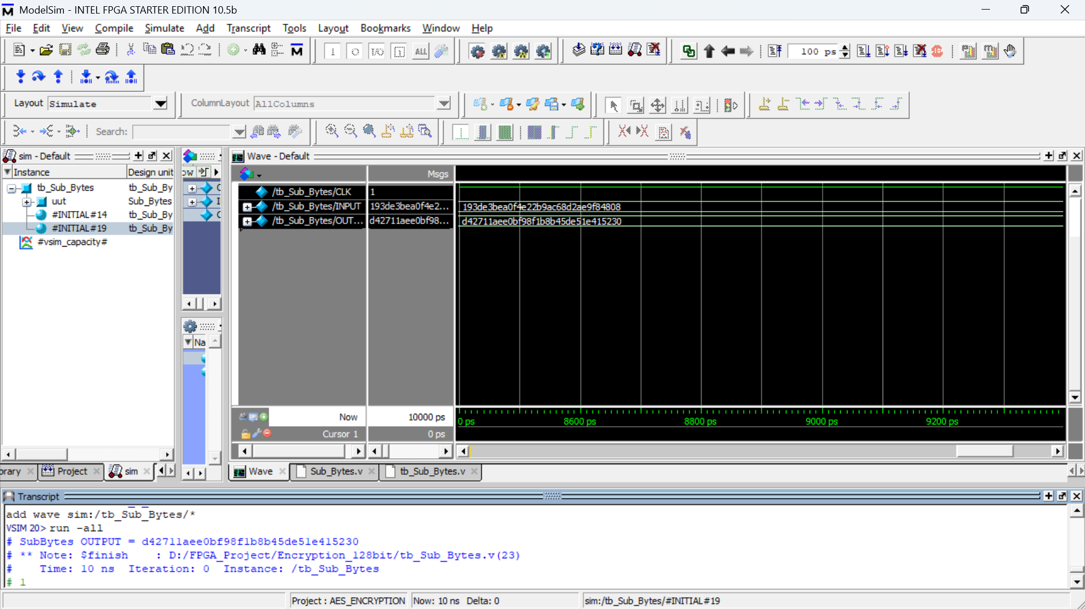
Results (Encryption)
Round 1 : Substitute Bytes Operation

Slide 14
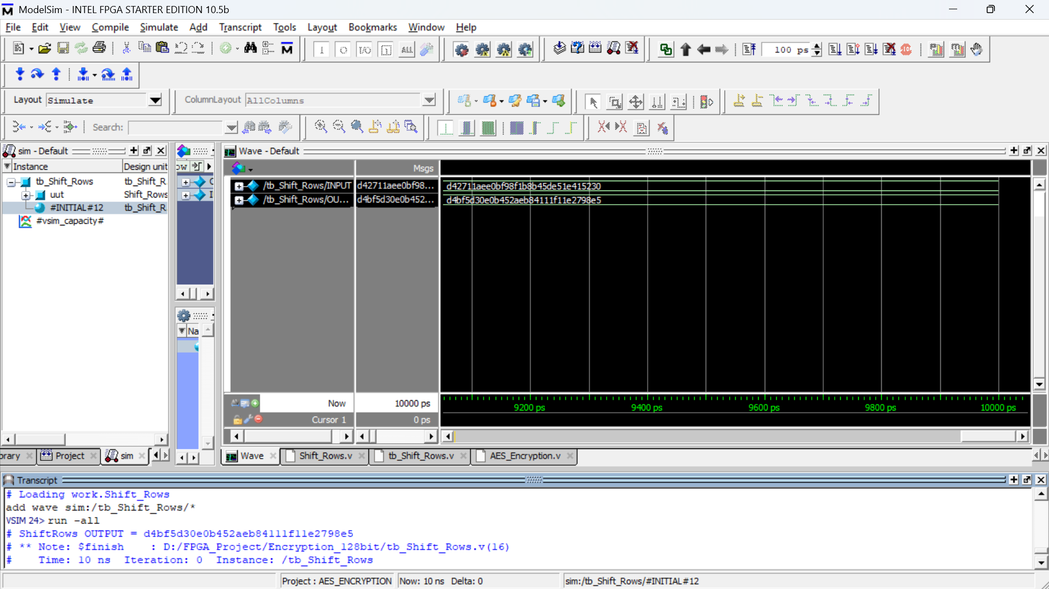
Results (Encryption)
Round 1 : Shift Rows Operation

Slide 15
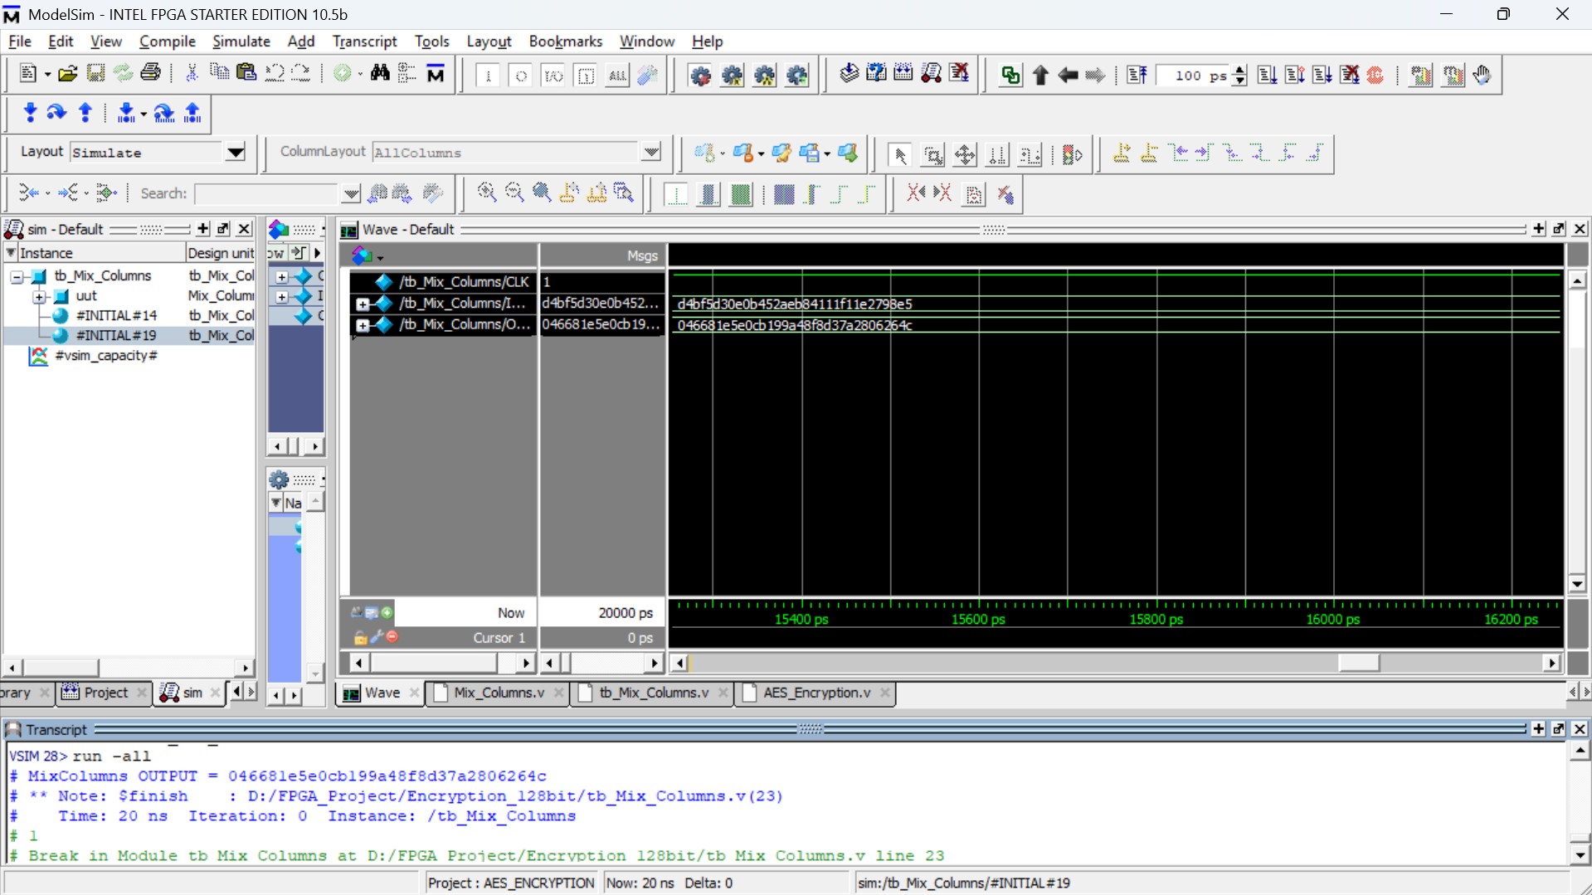
Results (Encryption)
Round 1 : Mix Columns Operation

Slide 16
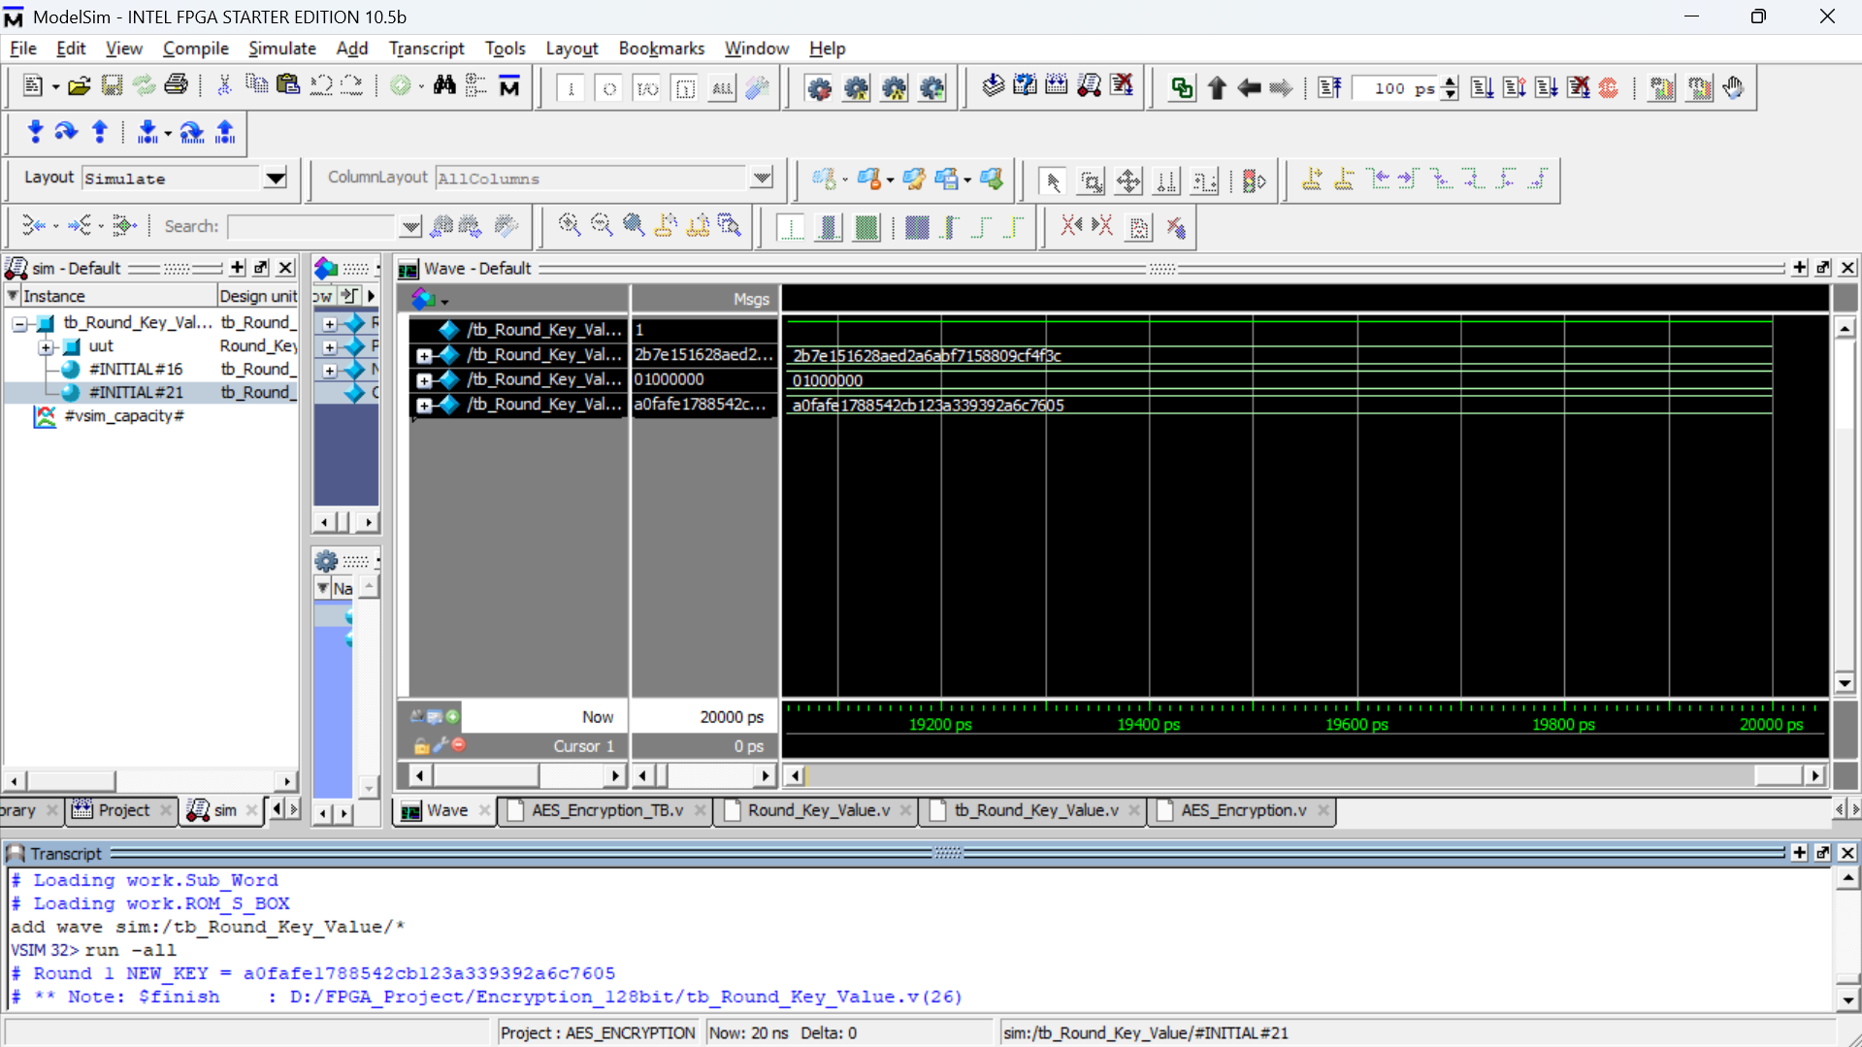
Results (Encryption)
Round 1 : Round Key Value For Performing Exor Operation

Slide 17
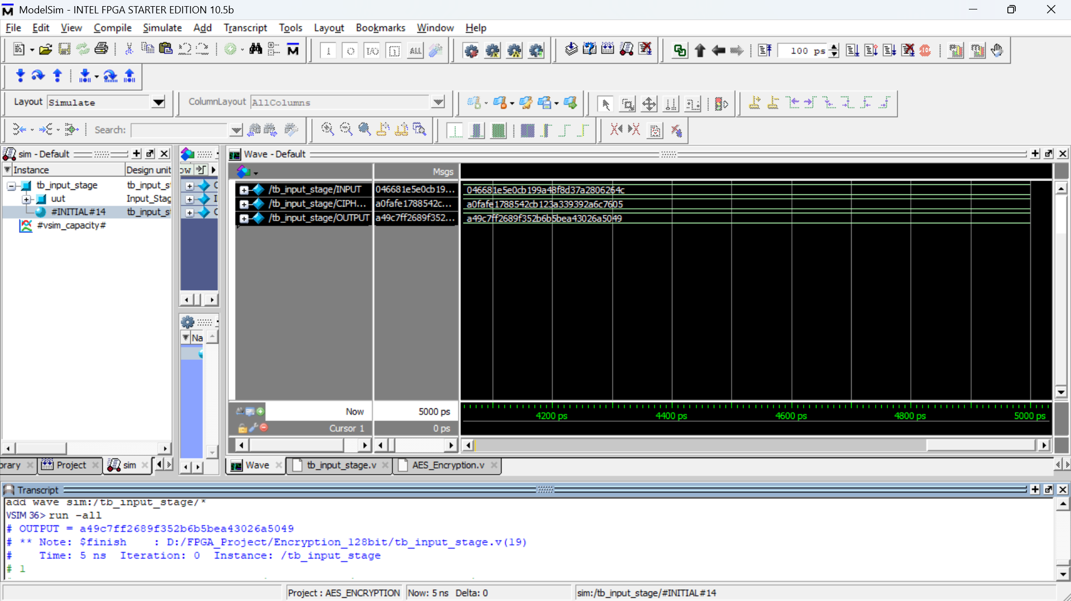
Results (Encryption)
Now Performing EXOR Operation of Input with New Key Generated From Round 1.

Slide 18
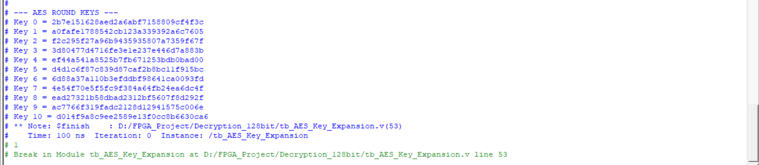
Results
All Round Key Values

Slide 19
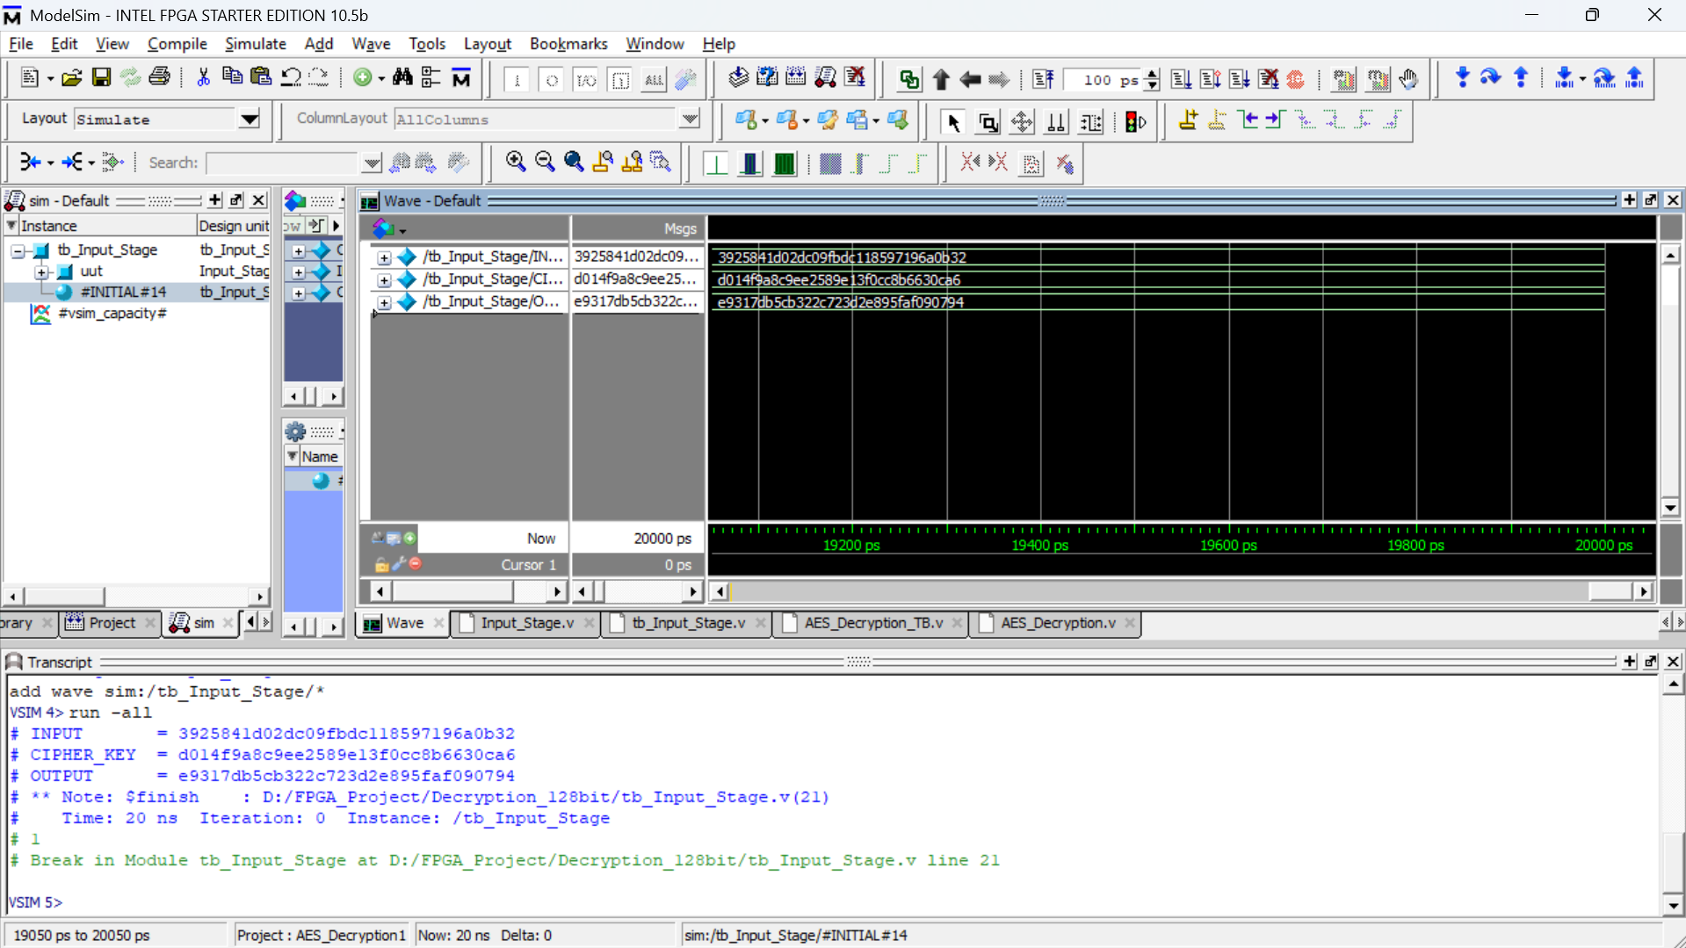
Results (Decryption)
Round 1 : Input Stage - (Encrypted Text ^ Round Key 10)

Slide 20
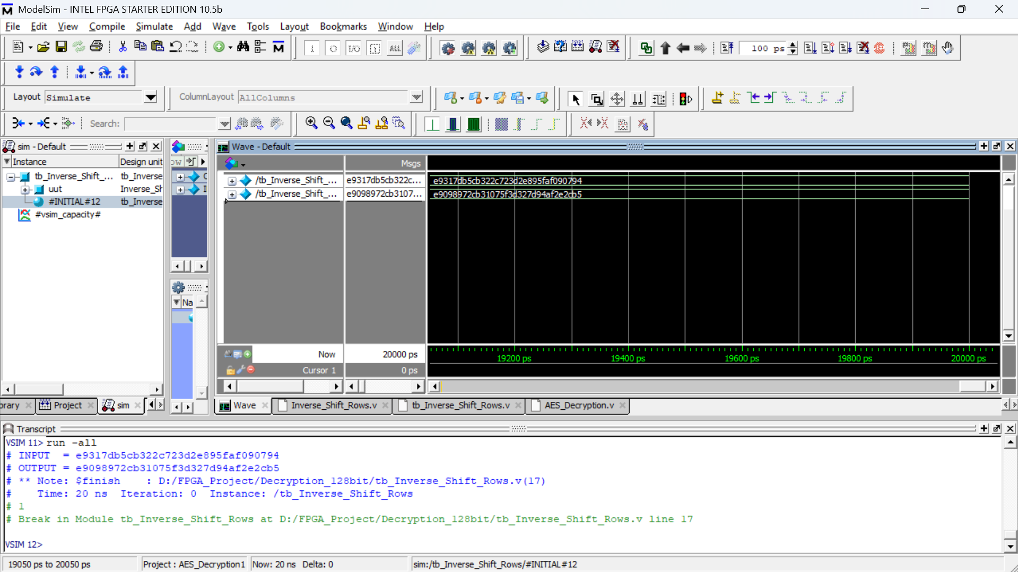
Results (Decryption)
Round 1 : Inverse Shift Rows Operation

Slide 21
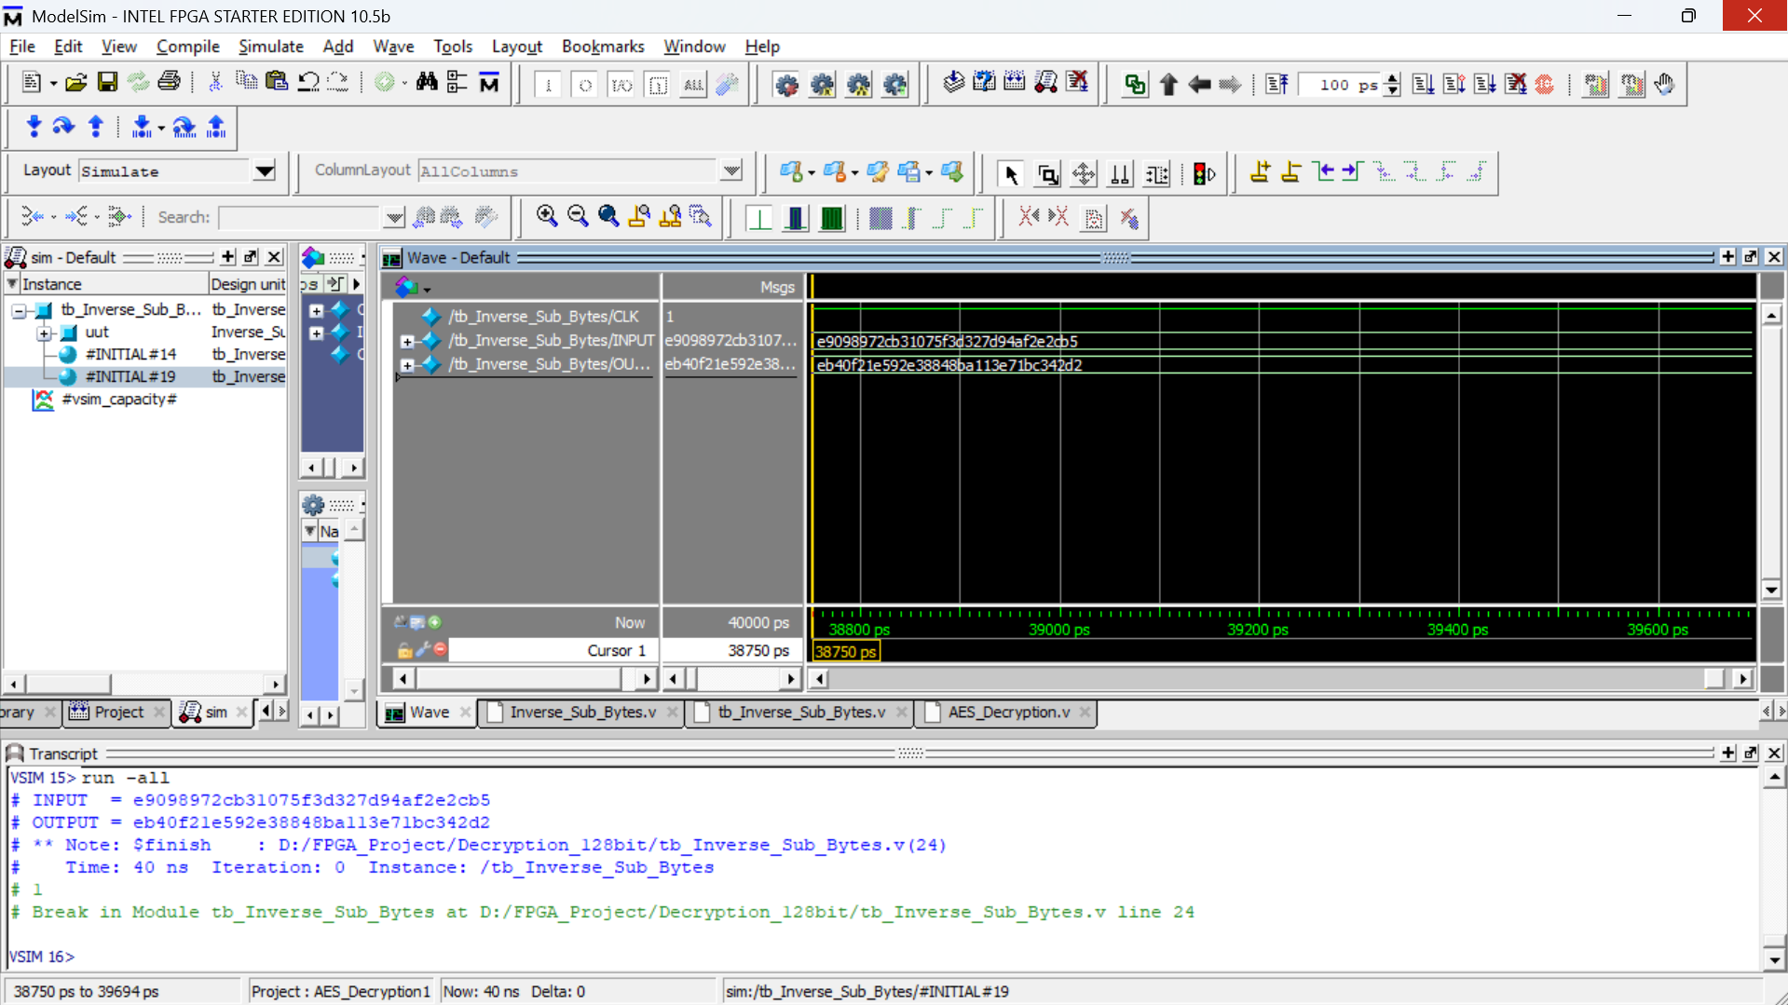
Results (Decryption)
Round 1 : Inverse Sub Bytes Operation

Slide 22
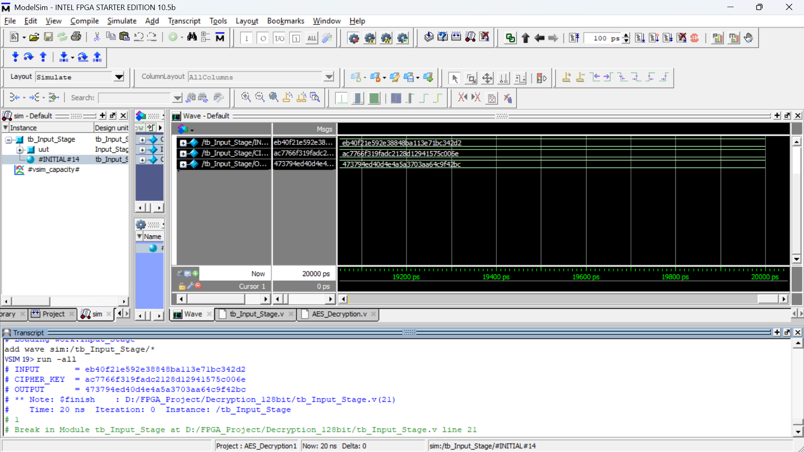
Results (Decryption)
Round 1 : Performing EXOR Operation of output of Inverse Sub Bytes with Round Key 9

Slide 23
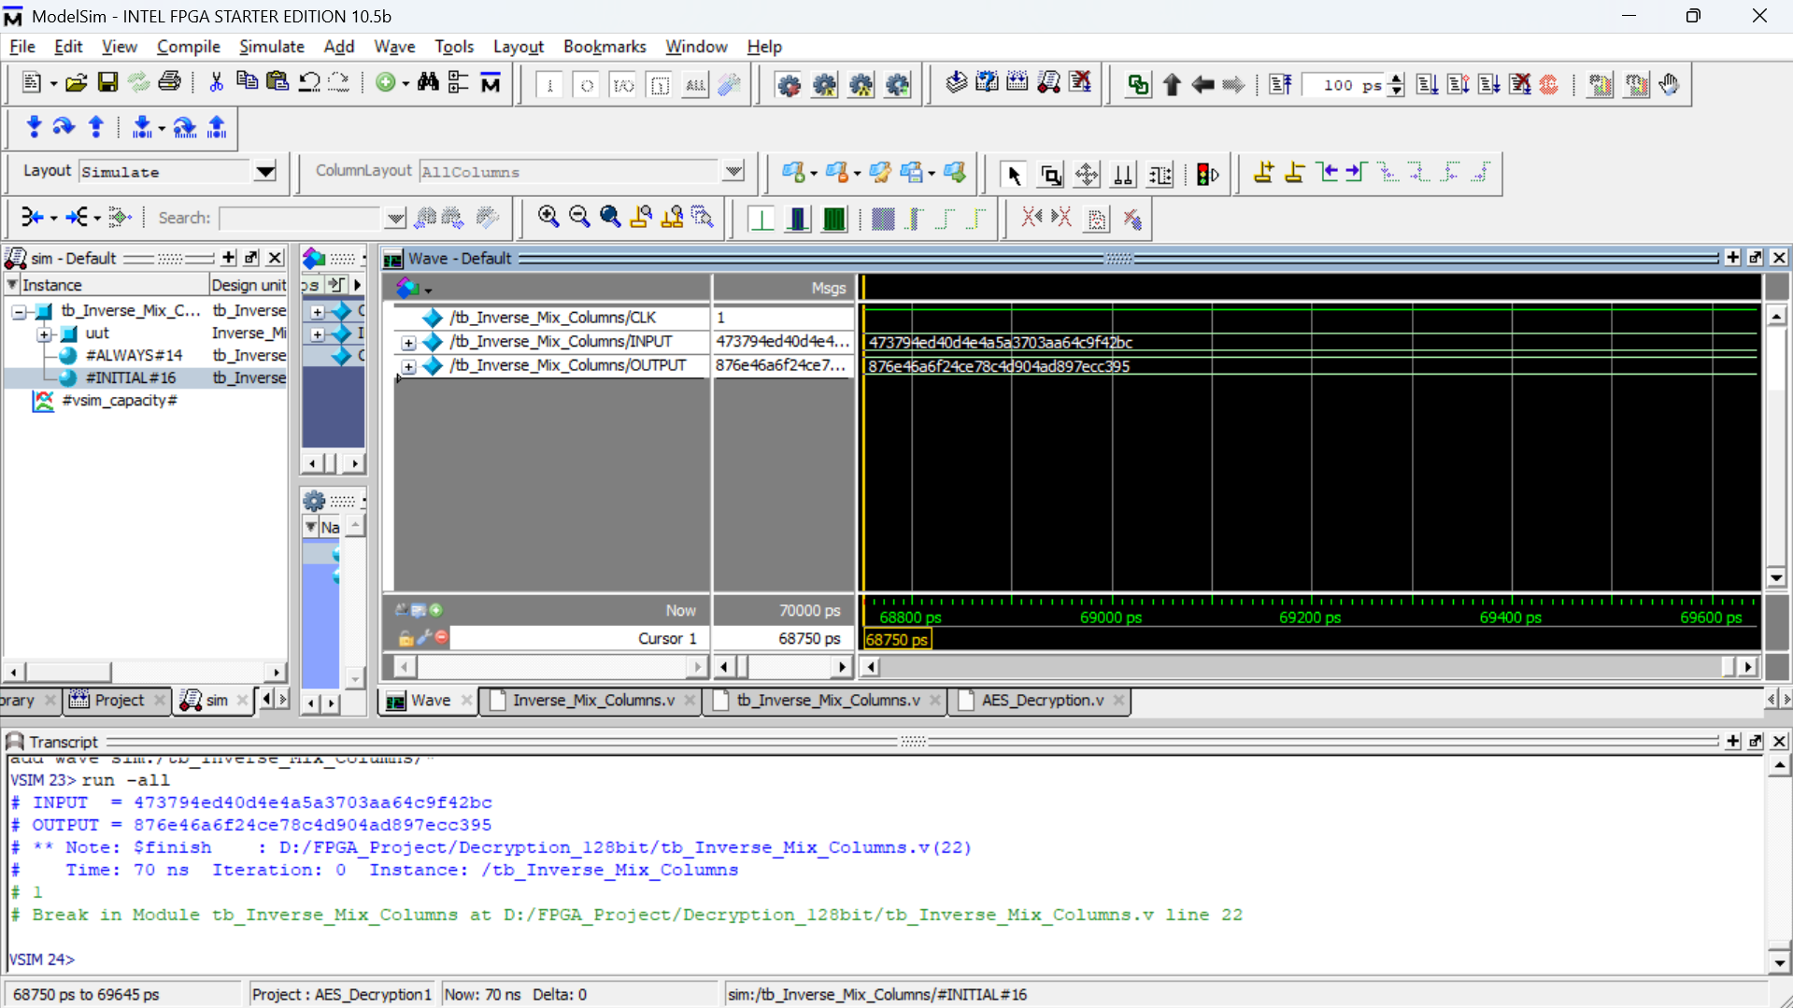
Results (Decryption)
Round 1 : Inverse Mix Columns Operation

Slide 24
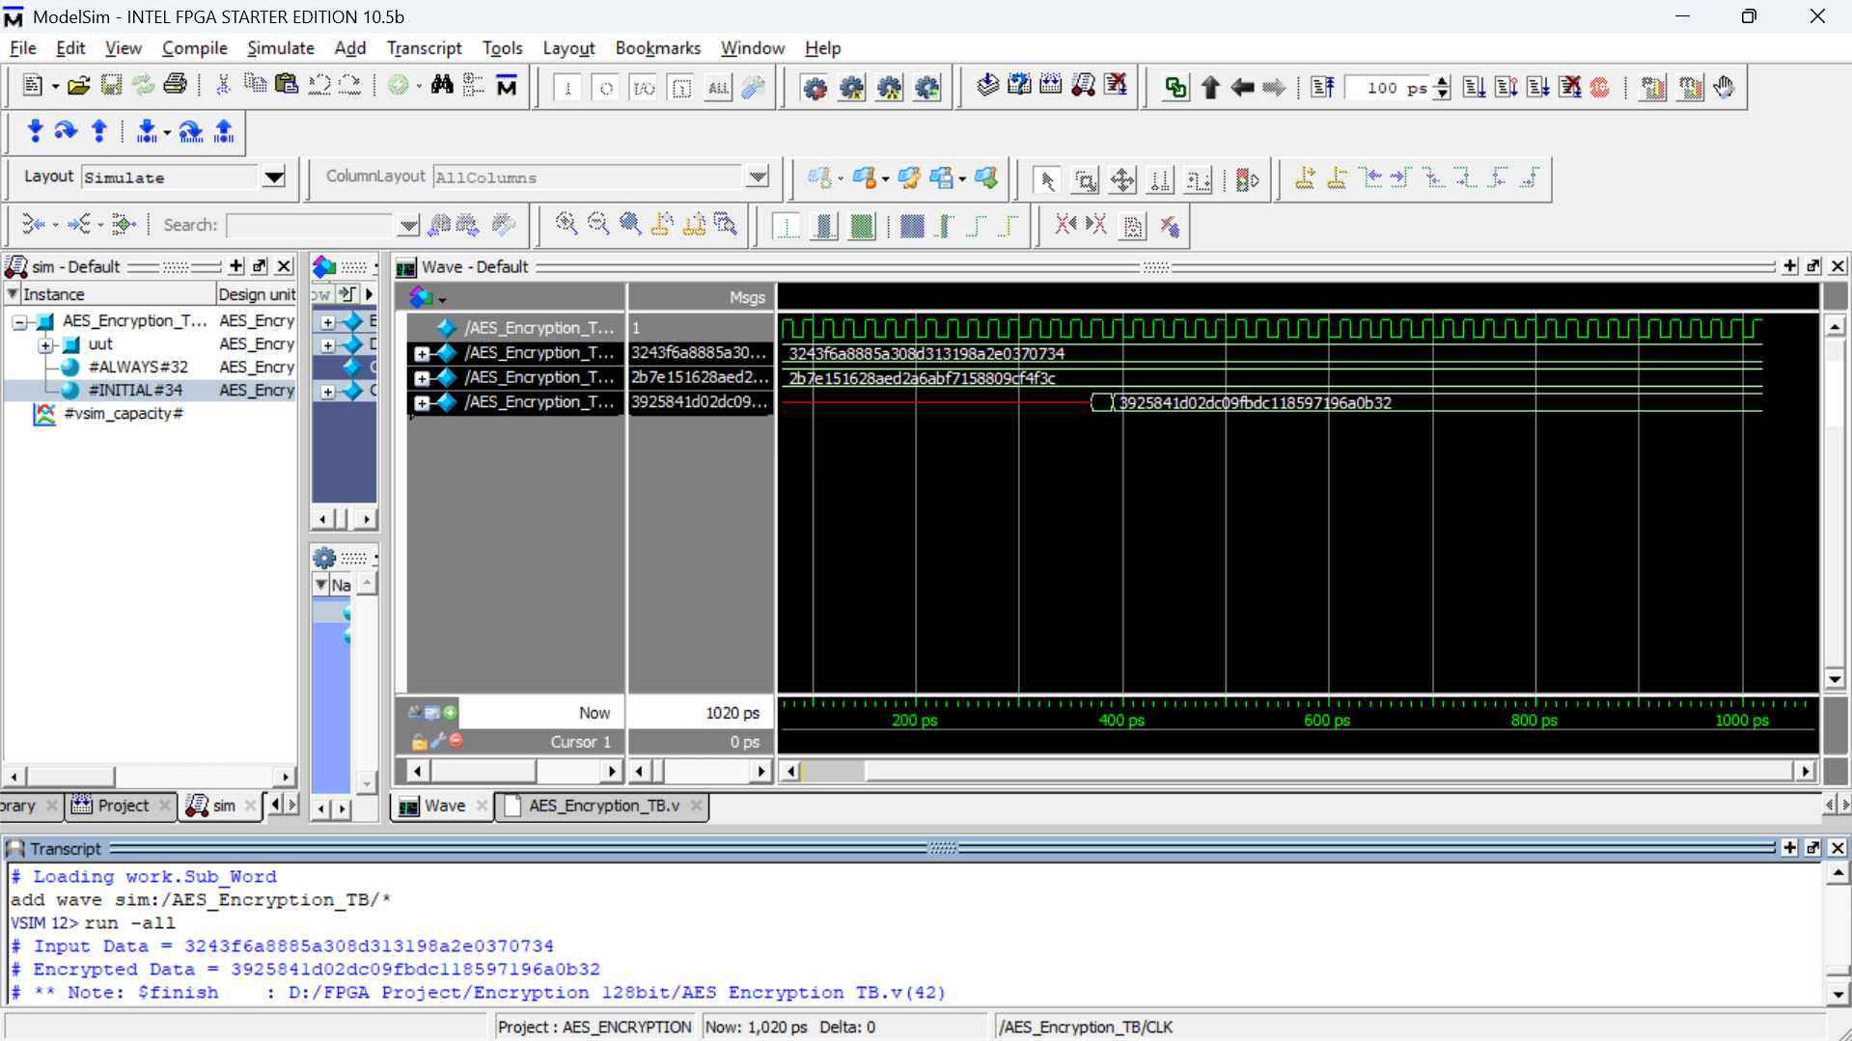
Encrypted data

Slide 25
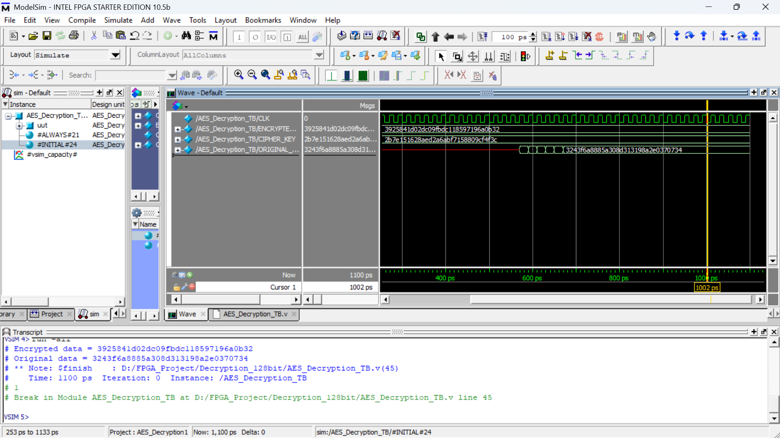
decrypted data - original data received

